Slide 1
Biannual Dendrometer Ipad Protocol

Slide 2
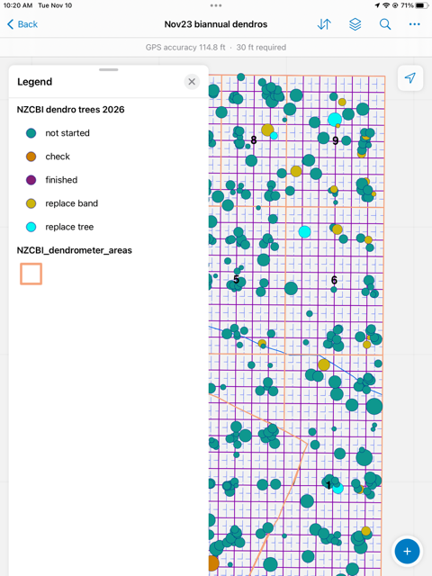
Everyone should have an offline map downloaded on the FieldMaps app titled “Nov 23 biannual dendros” that looks like this:
Dots will turn teal to purple as we complete them, do not visit replace band (yellow) or replace trees (cyan) for now
Every person or pair will be assigned a numbered section to work in

Slide 3
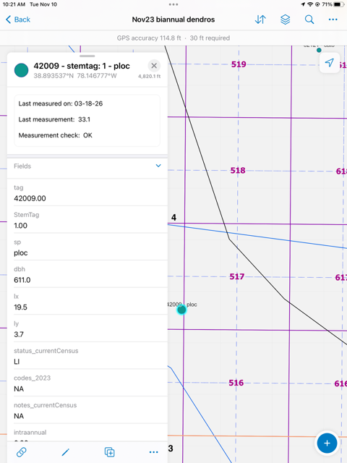
To complete a tree click on the dot and this menu will come up
To record the measurement click the “two chains” at the bottom

Slide 4
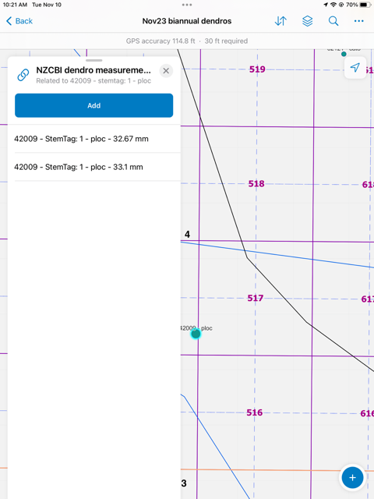
This menu will come up showing all the previous measurements for this tree
Click Add to add a new one

Slide 5
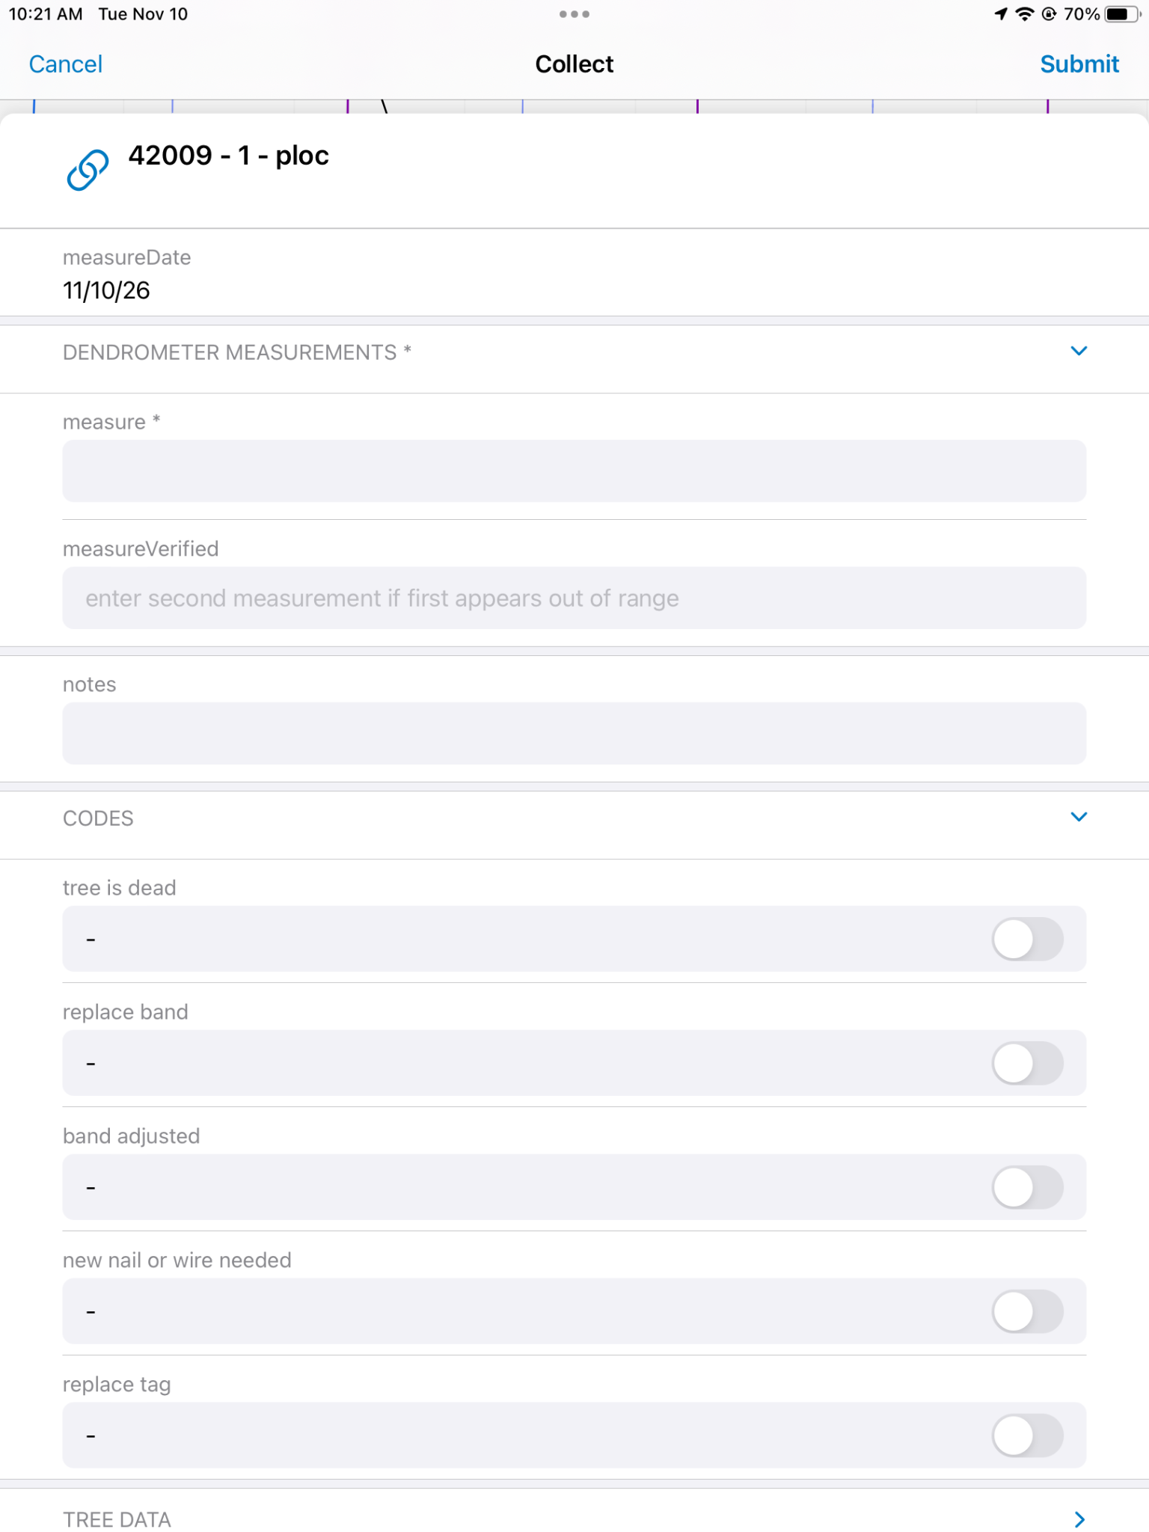
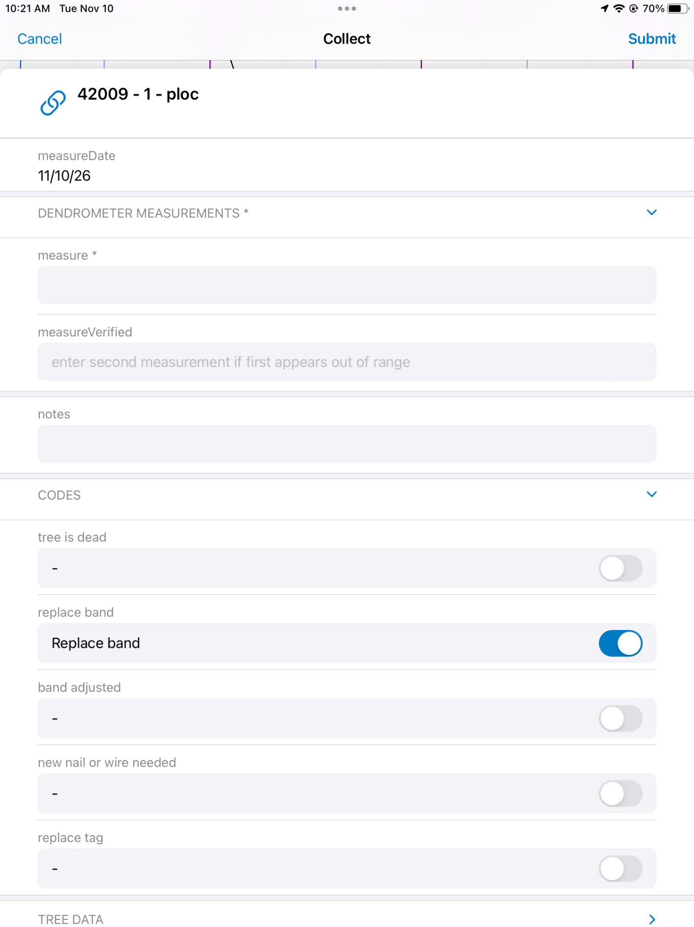
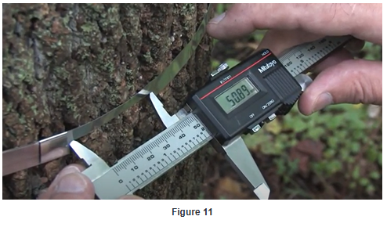
Record the new measurement in mm in the measure field (How To)
If the tree is dead, needs a new band, needs the band adjusted, or needs a new nail or wire toggle that option on in the codes
If the measurement is too high or too low (will be flagged on the next slide) take a second measurement and enter it in the measure verified field
Click submit
Toggled on:

Slide 6
Lastly return to this menu and click edit (the pencil)

Slide 7
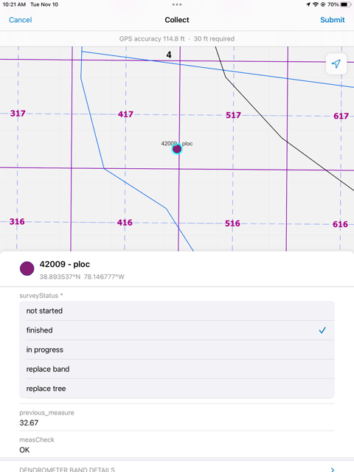
Change the status of the tree to finished (dot should turn purple)
IMPORTANT: Look to see if measCheck says OK – if not take a second measurement and add it in measurement verified
Hit submit

